Slide 1




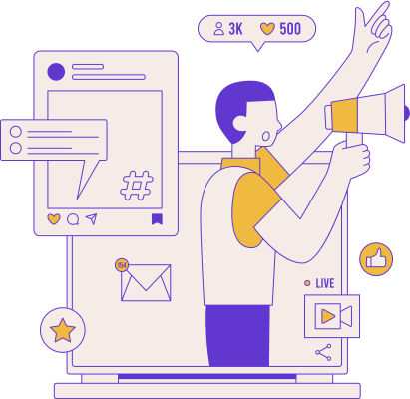

Creator
Link
Redifining Influencer Marketing.
Mythic Giants

Slide 2

Introduction
The Problem: Influencer marketing is growing, but connecting creators with brands is still challenging and inefficient.
Our Solution: CreatorLink - a platform which connects influencers with advertisers, categorizing them by audience and engagement, and providing analytics for optimized campaigns.
Benefits: Streamlines partnerships, enhancing campaign effectiveness and ROI for both creators and advertisers.

Slide 3

Target audience
Growing Content creators who need brand deals to take their channel to the next level.
Companies who want to do better advertise to relevant audiences.

Slide 4

Feasibility and Scalability
Feasibility:
CreatorLink's tech stack will integrate seamlessly with major social media platforms and payment systems.
CreatorLink will use algorithms to match creators with advertisers based on audience demographics, content niche, and engagement metrics.
The platform will offer in-depth analytics to track campaign performance and provide recommendations for data-driven decisions.
Scalability:
Cloud-Based Infrastructure: We will use cloud-based services to handle increasing user loads and transaction volumes for seamless scaling.
Streamlined Systems: We will employ automated processes for user onboarding, campaign management, and analytics to ensure appropriate scaling keeping in mind performance or user experience.

Slide 5

Business Model
Brands who want to advertise sign up for an account with a recurring subscription.
Through a tier-based system, the brands are then able to pick and choose packages that sort creators into categories and specifics such as number of platforms, type of content and overall success rates.
The platform implements a scalable approach which takes into consideration the company’s budget, campaign size, runtime as well as number of sponsored segments.
The brand pays for the sponsorship package, wherein the platform takes a small cut of the total, with the rest going towards the creator. This proportion favors the majority towards the creators to ensure client trust as well as the platform’s longevity.
This ensures that the platform is financially feasible in the long run and remains accessible to up-and-coming brands as well as growing creators, helping establish a solid consumer base in the long run.

Slide 6

LinkPro
Creators who have shown consistent growth are offered access to exclusive opportunities through LinkPro.
With LinkPro, the creators gain access to more features-
First priority membership: Priority access to high-value sponsorship opportunities and exclusive brand partnerships.
More favorable revenue split: With LinkPro, creators are offered higher profit splits
Milestone Payments: When specific performance milestones are met, such as driving 1,000 purchase orders or achieving a set number of clicks, sign-ups, bonuses are offered to creators, further incentivizing performance.
Tiered Goals: Multiple tiers of milestone goals (e.g., 500 orders, 1,000 orders, 2,000 orders), with incremental payments or bonuses for each tier reached, encouraging creators to exceed baseline targets.

Slide 7

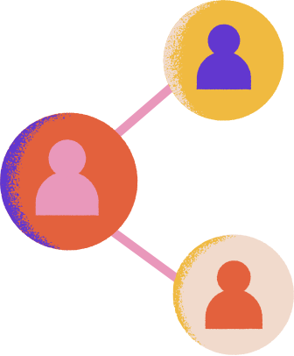












Roadmap
Creator Market Fit
Audience Alignment
Post Sponsorship Analytics
Companies define their marketing needs and present their goals.
After getting the demographic information from the creator,
audience is better matched with sponsorships
After having done the sponsor deal, the companies get feedback on their ad-read based on many metrics.
01
03
05
Sign-up
Creator API
Sponsorship Negotiation
02
Creators provide access to their analytics dashboard since the YouTube public API is limited in the information that it provides
04
06
In this initial phase, both Creators and Companies create an account on Creator link
Creators interact with the companies through our platform.

Slide 8

Technical Approach
Front-End Development:
HTML, CSS, JavaScript: Used for building the user interface and ensuring a responsive design.
Back-End Development:
Node.js: Provides server-side JavaScript execution for handling requests and running the application.
Express.js:
Framework for creating APIs and managing server-side routes and logic.
Database Management:
MySQL: Used for storing and managing user and campaign data.
Design and Presentation:
Figma: Tool for designing UI/UX and creating prototypes.Canva: Tool for designing presentations and visual assets.

Slide 9








Impact of creator link on the industry
Identify Growing Creators with the need of brand deals.
Help strike a brand deal with conditions that are agreed by both parties.
Finding Creators who don’t get much ad revenue and need brand deals to sustain and grow.
1
4
Identify how much each brand wants to spend and how much each creator wants to charge and align both parties based on their needs.
Identify Emerging Brands in need of creators to promote their products.
2
Make the deal successful with proper implementation.
5
Supervise and make sure committed videos are posted on said date and time to foster a good relationship between both parties.
Finding Brands who want to find creators who will promote their products on their own social media handles.
3
6
Help creators find their suitable advertisable brands and vice versa.
Ensure Payment is cleared and both parties are content
Help brands find the creators they want to work with and help creators work with their niche-aligned brands.
Ensure that brands are clear with their payments creators receive their promised amount and both sides and content with the execution of the deal.

Slide 10





Our Team
Somesh
Nirvaan
Team leader
Shaurya
Soham

Slide 11


Thank You

